Slide 1

Zettafly: A Network Topology with Flexible Non-blocking Regions for Large-scale AI and HPC Systems
Authors: Dezun Dong, Ziyu Wang, Fei Lei
Speaker: Ziyu Wang Time: 2025-6-24
HiNA Lab: High Performance Networking and Architecture
Notes:
Hello everyone, I am Ziyu Wang, a second-year Ph.D. student from the National University of Defense Technology in China. My supervisor is Dezun Dong. It is my honor to present our latest paper at the ISCA conference today.

Slide 2
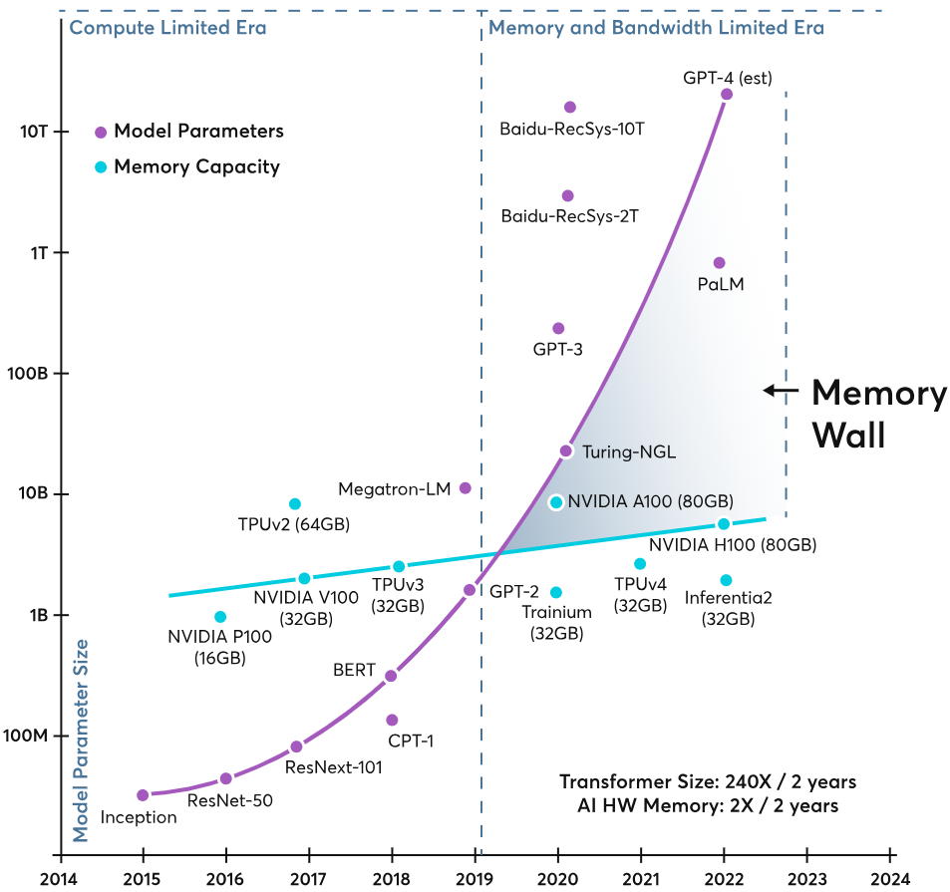
The era of large-scale interconnected systems is on the horizon
The growth rate of AI demand is far faster than the pace of hardware development
[1] Memory Wall. https://ayarlabs.com/glossary/memory-wall
Notes:
AI drives the development of supercomputers, with AI demand growing much faster than hardware improvement. This makes building larger interconnected systems with more nodes inevitable. Topology is critical in designing interconnected systems, as it largely influences the cost and performance of the network.

Slide 3
Requirements for topology design in large-scale systems
Low diameter
Lower zero-load network latency
High bandwidth
Better performance & throughput
Scalability
Maximum supported node count
Deployability
The network should be easily understandable and support modular packaging
Job isolation
Interference-free traffic for concurrent jobs
Cost-effectiveness
Reasonable network cost
Notes:
We believe that topology design should take into account metrics such as low diameter, high bandwidth, scalability, deployability, job isolation, and cost efficiency. When considering post-Exascale and Zettascale supercomputers with over one hundred thousand nodes, existing topologies still have room for optimization in balancing these metrics.

Slide 4
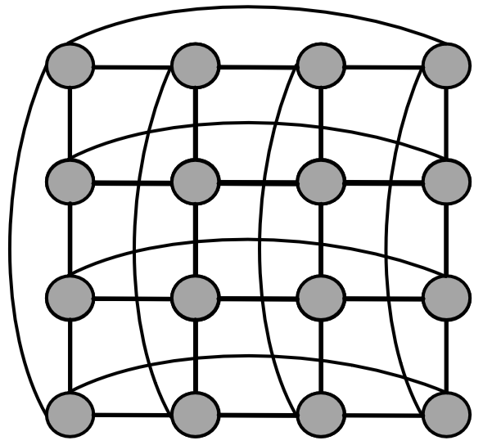
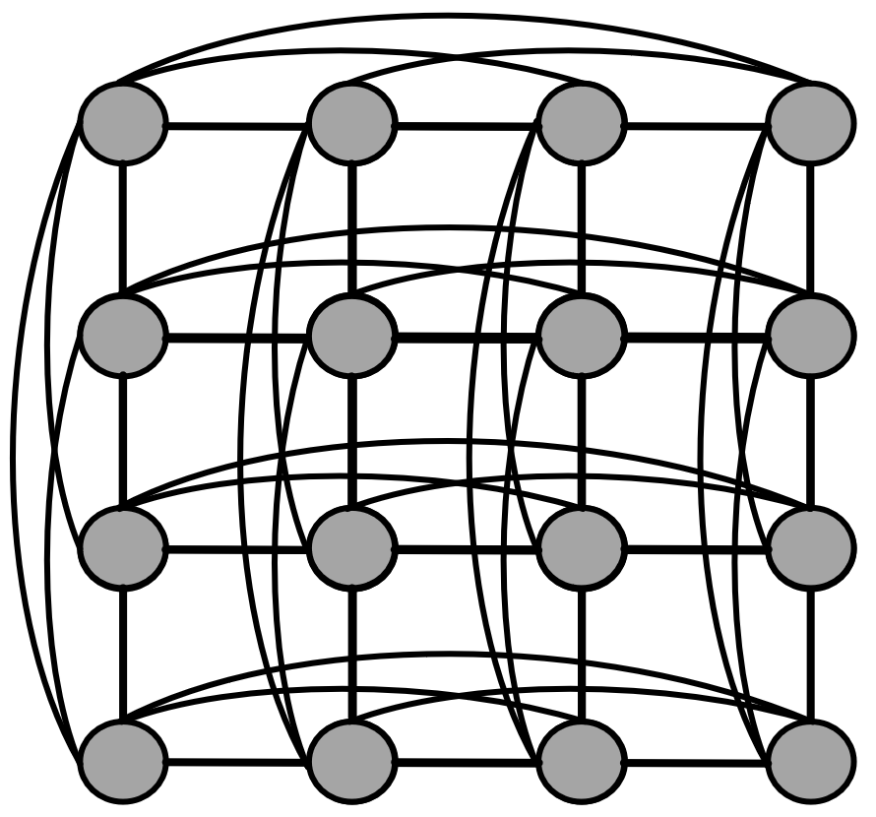
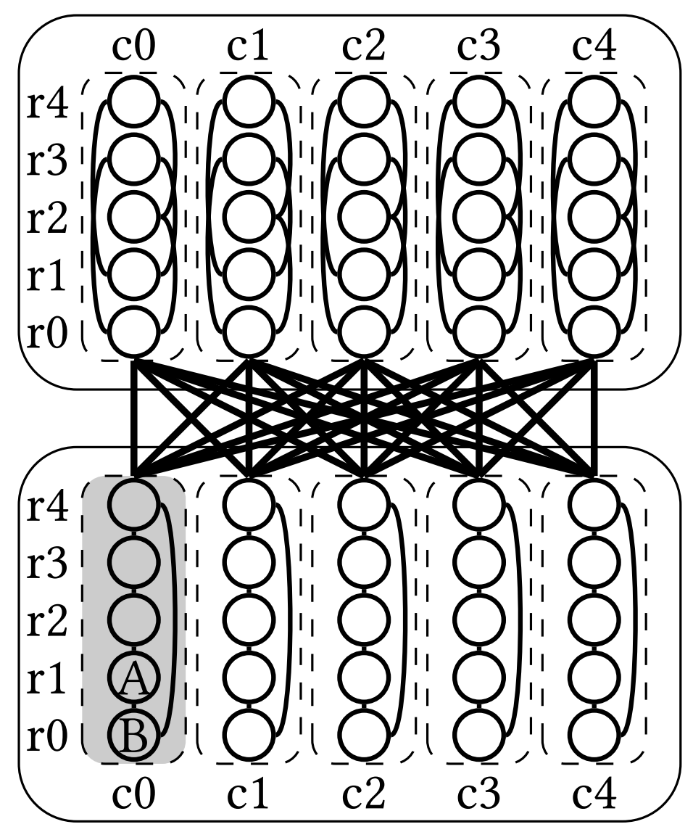
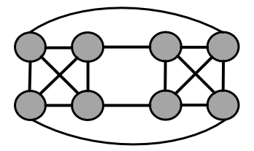
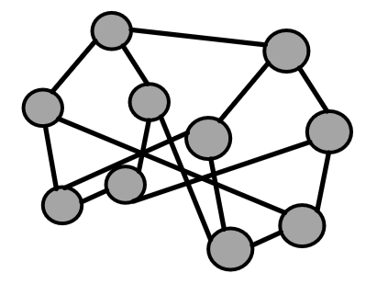
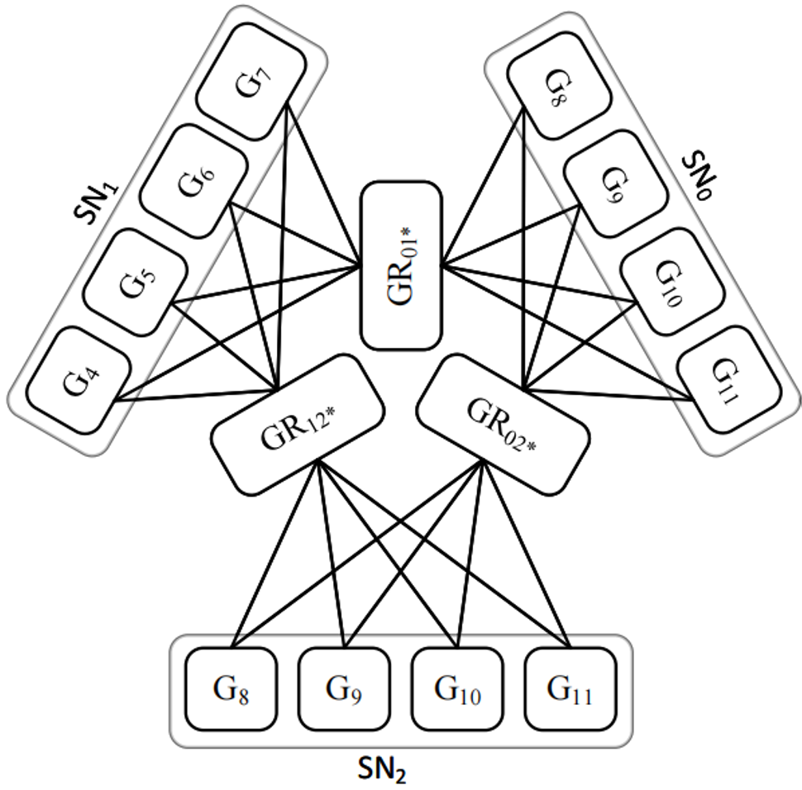
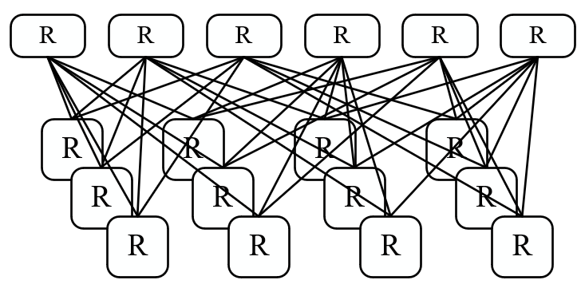
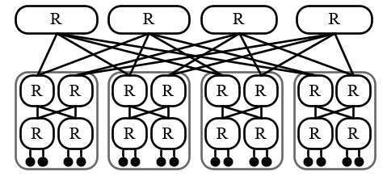
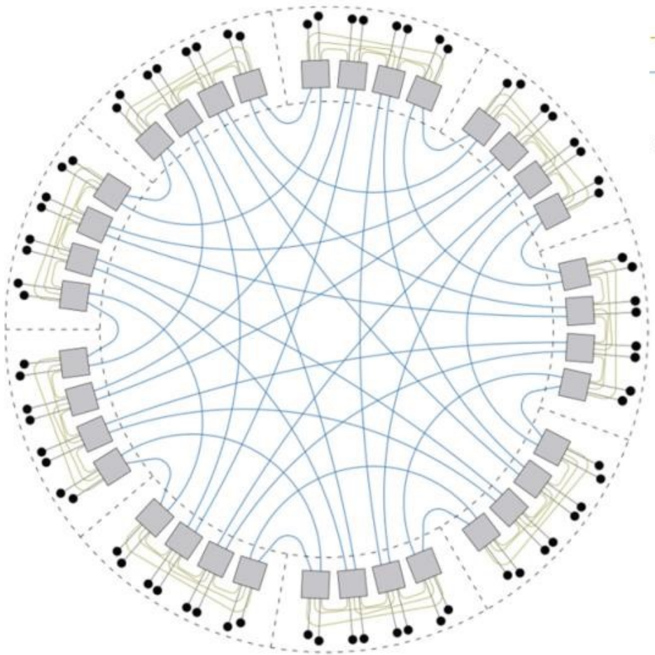
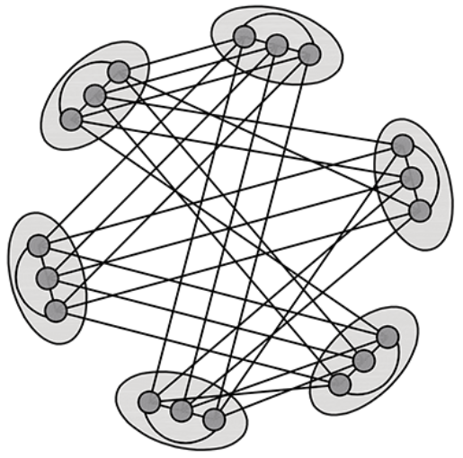
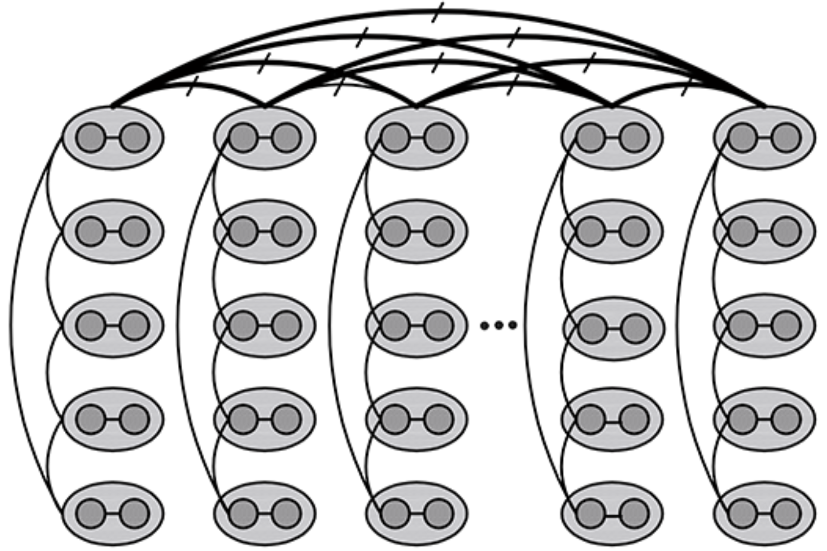
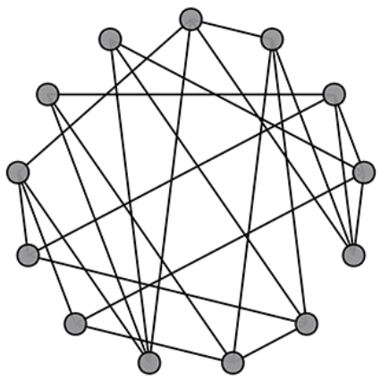
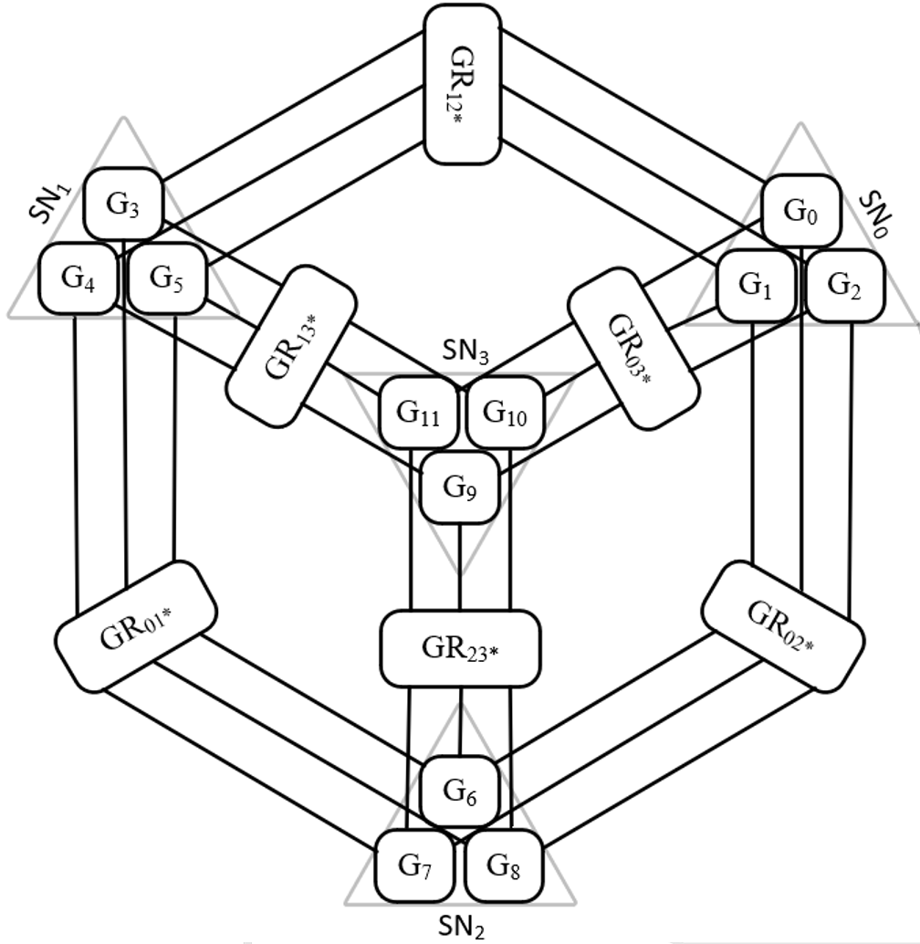
A brief history of off-chip topologies
Torus Flattened-Buterfly HyperX MLFM Bundlefly Polarstar Zettafly-3
1980s 2007 2009 2015 2020 2023 2025
1990s 2008 2014 2016 2022 2025
Fat-tree Dragonfly Slim Fly Galaxyfly Polarfly Zettafly-4
Notes:
Let's briefly review the representative off-chip topologies proposed over the past 40 years.

Slide 5
Topologies with good moore bound efficiency: diameter-2
Slim Fly [1] MLFM [2] Polarfly [3]
[1] Maciej Besta and Torsten Hoefler. Slim fly: a cost effective low-diameter network topology (SC ’14)
[2] Georgios Kathareios, Cyriel Minkenberg, Bogdan Prisacari, German Rodriguez,
and Torsten Hoefler. Cost-effective diameter-two topologies: analysis and evaluation (SC’15)
[3] Kartik Lakhotia, Maciej Besta, Laura Monroe, Kelly Isham, Patrick Iff, Torsten
Hoefler, and Fabrizio Petrini. PolarFly: a cost-effective and flexible low diameter topology (SC’22)
Notes:
These topologies can be divided into two categories, the first of which focuses on achieving extreme Moore bound efficiency. Higher Moore bound efficiency means that fewer switches and cables are required to interconnect the same number of nodes, leading to lower network costs. Topologies such as Slimfly, multi-layer full mesh, and Polarfly, which are diameter-2 topologies, exhibit good Moore bound efficiency. However, under 64-port switches, they can only support networks with up to tens of thousands of nodes, falling short of the requirements for large-scale interconnection of 100,000 nodes.

Slide 6
Topologies with good moore bound efficiency: diameters 3 or 4
Galaxyfly [1] Bundlefly [2] Polarstar [3]
[1] Fei Lei, Dezun Dong, Xiangke Liao, Xing Su, and Cunlu Li. Galaxyfly: A Novel Family of Flexible-Radix Low-Diameter Topologies for Large-Scales In terconnection Networks (ICS ’16)
[2] Fei Lei, Dezun Dong, Xiangke Liao, and José Duato. Bundlefly: a low diameter topology for multicore fiber (ICS’20)
[3] Kartik Lakhotia, Laura Monroe, Kelly Isham, Maciej Besta, Nils Blach, Torsten Hoefler, and Fabrizio PetriniPolarStar: Expanding the Horizon of Diameter-3 Networks. (SPAA’24)
Notes:
Galaxyfly, Bundlefly, and Polarstar, which are diameter-3 or higher topologies, also exhibit excellent Moore bound efficiency and cost-effectiveness. However, their network structures are overly complex, making large-scale deployment and maintenance challenging.

Slide 7
Classical topologies validated through practical implementation
Torus HyperX [1] Dragonfly [2] Fat-tree
[1] Jung Ho Ahn, Nathan Binkert, Al Davis, Moray McLaren, and Robert S. Schreiber. HyperX: topology, routing, and packaging of efficient large scale networks (SC’09)
[2] John Kim, Wiliam J. Dally, Steve Scott, and Dennis Abts. Technology Driven, Highly-Scalable Dragonfly Topology (ISCA’08)
Notes:
Unlike topologies aiming for Moore bound efficiency, another category builds networks modularly using simple, intuitive components. However, for large-scale deployment, classic topologies like Torus, HyperX, and Fat Tree have lower cost-efficiency. Dragonfly offers good cost-efficiency and scalability but suffers from low bandwidth due to limited global links. Moreover, except for Fat Tree, other topologies lack effective job isolation, making jobs vulnerable to network noise.

Slide 8
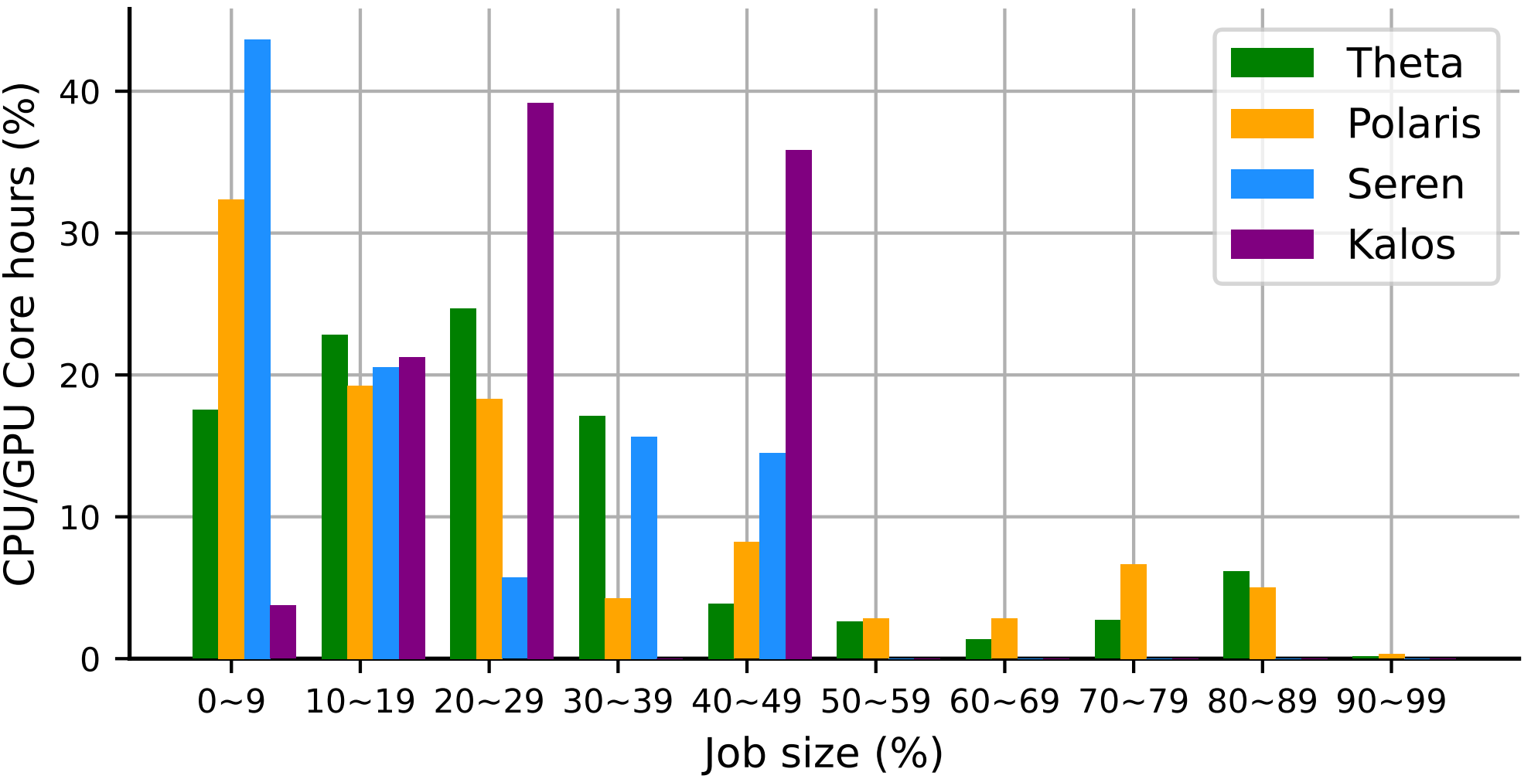
The characteristics of job size distribution in practical systems.
70% of core hours is consumed by small to medium-sized jobs utilizing less than 30% of the nodes.
Major tasks (utilizing over 80% of nodes) consume only approximately 6% of core hours.
Notes:
We bilieve topology design must account for job size distribution. Theta and Polaris are two supercomputers from Argonne National Laboratory, historically ranked in the Top500's top 20, while Seren and Kalos are AI data centers from Shanghai AI Lab. Based on 2023 job logs from these four systems, the figure shows the relationship between job size and consumed core hours. Across both HPC and AI domains, approximately 70% of core hours are consumed by small to medium jobs, while large jobs using over 80% of nodes account for only about 6% of core hours.

Slide 9
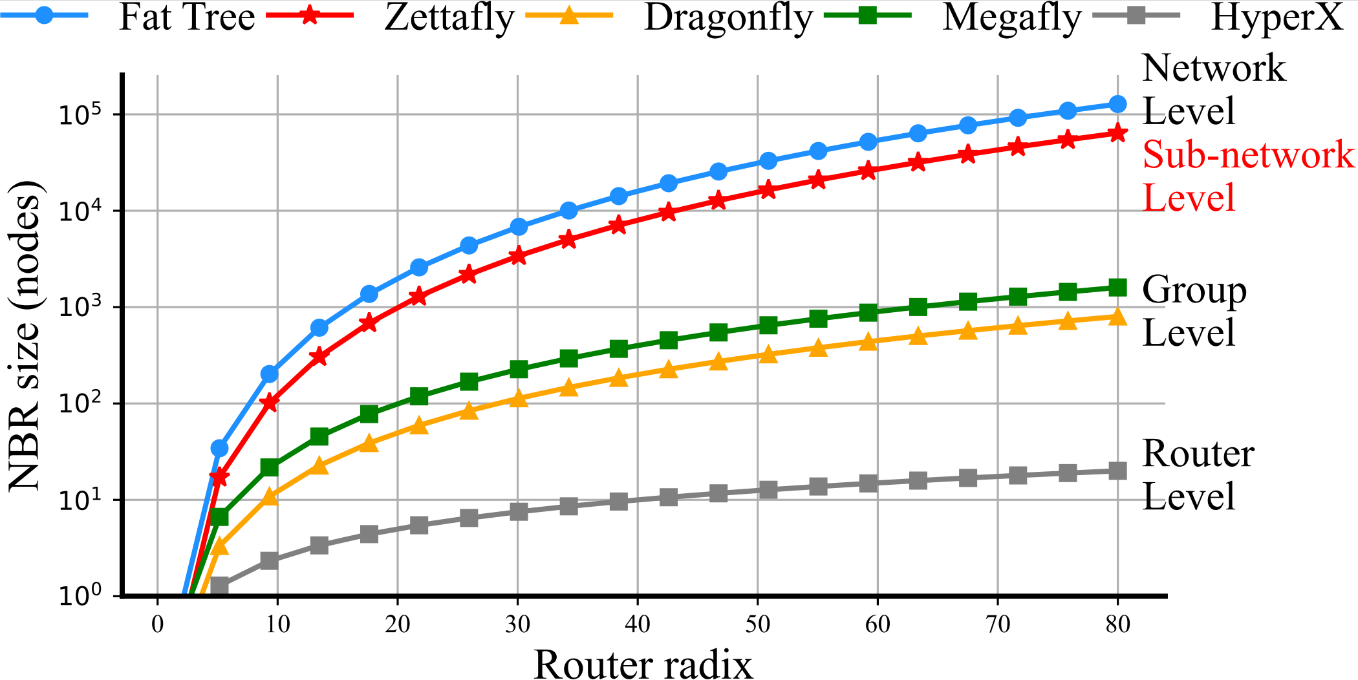
The NBR size across different topologies
Non-Blocking Region (NBR)
The NBR of all topologies, except Zettafly, is two orders of magnitude lower than that of the Fat-tree.
Notes:
All topologies have specific non-blocking regions, which provide sufficient bandwidth for nodes to achieve saturated bandwidth under any non-hotspot traffic patterns. This region represents the ideal network environment for any job. In a non-blocking Fat Tree, the entire network is non-blocking, while Dragonfly and Megafly achieve non-blocking only at the group level, and HyperX limits it to the router level. Since small to medium jobs consume most core hours and their traffic only utilizes a small portion of the network, a fully non-blocking Fat Tree is unnecessary, while other topologies have overly small non-blocking regions, at least two orders of magnitude smaller than Fat Tree. This suggests a better trade-off point. The proposed Zettafly achieves non-blocking regions at the sub-network level, second only to Fat Tree. The primary motivation behind the Zettafly design is to achieve efficient job isolation. Zettafly consists of multiple large non-blocking sub-networks, allowing better isolation for small to medium jobs within a single sub-network.

Slide 10
Construction of the Zettafly network
A single router connecting any number of nodes forms the simplest non-blocking region.
Router
…
N₀ N₁ N₂ N₃ N₄ N₅ N₆ N∞
Notes:
Next, let's introduce Zettafly from a bottom-up perspective. The mathematical definition of Zettafly can be found in the paper. A single router connecting any node forms the simplest non-blocking region, as the router chip itself is non-blocking. In an ideal scenario with an infinite-port router, all nodes could connect to it, creating the perfect network. However, the number of ports on a router is limited.

Slide 11
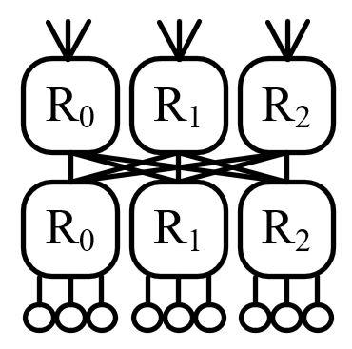
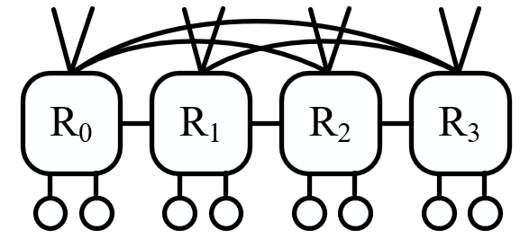
Construction of the Zettafly network
Multiple routers form a group-level non-blocking region
Zettafly-3: fully-connected network
Zettafly-4: two-level fat-tree
Notes:
To get a bigger non-blocking region, multiple routers must be connected to from a group. Although the groups in Zettafly can be arbitrary low-diameter non-blocking networks, our design focuses on two group structures: One is the same fully connected network as the Dragonfly group, while the other is the same two-level fat-tree as the Megafly group. These group structures affect network diameter, distinguished as Zettafly-3 and Zettafly-4.

Slide 12
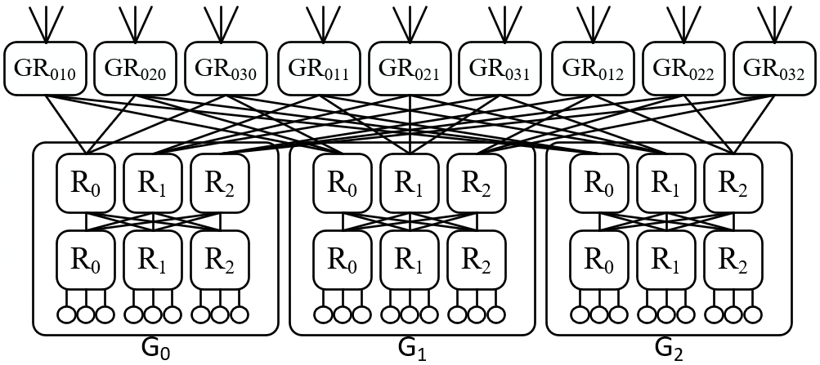
Construction of the Zettafly network
Multiple groups form a sub-network (SN) through global routers (GRs)
SN₀：
Notes:
Multiple groups connect via global routers to form a non-blocking sub-network. As shown, with a 2-level fat-tree intra-group structure, a sub-network of Zettafly-4 resembles a 3-level Fat Tree where half of the ports on its root switches are dangling.The global router in Zettafly-4 acts as a shared root switch for 2, 3-level Fat Trees. Thus, Zettafly sub-networks are non-blocking.

Slide 13
Construction of the Zettafly network
Fat-tree:Composed of two non-blocking sub-networks.
Zettafly-4: Composed of multiple non-blocking sub-networks.
SN₀：
SN₁ SN₂ SN₃ SN₁ SN₂ SN₃ SN₁ SN₂ SN₃
Notes:
The key difference between Zettafly-4 and 3-level Fat Tree is that Fat Tree consists of only two such sub-networks, while Zettafly-4 includes multiple sub-networks, with each global router bridging two sub-networks.

Slide 14
Construction of the Zettafly-4 network
Notes:
Here is an overview of a Zettafly-4 with four subnets and expands on sub-network 0. Each sub-network has 3 groups.

Slide 15
Construction of the Zettafly-4 network
Notes:
Any two sub-networks are bridged by 3 global routers. And GRpq* represents the 3 global routers connected to sub-network p and sub-network q. For example, the blue GR01* in the overview corresponds to GR010, GR011, and GR012 in the expanded diagram below. Additionally, the connections in the overview actually correspond to three lines in the expanded diagram below.

Slide 16
Construction of the Zettafly-4 network
Notes:
Similarly, these three green global routers bridge sub-network 0 and sub-network 2.

Slide 17
Construction of the Zettafly-4 network
Notes:
And the three orange global routers bridge sub-network 0 and sub-network 3.

Slide 18
Construction of the Zettafly-4 network
Notes:
During the inter-group connection process, we ensure that any two groups in the network are directly connected by at least one global router.

Slide 19
Construction of the Zettafly-3 network
Notes:
Zettafly-3's inter-group connections are the same as Zettafly-4, differing only in intra-group structure. The diagram shows an overview of Zettafly-3 with 3 sub-networks.

Slide 20
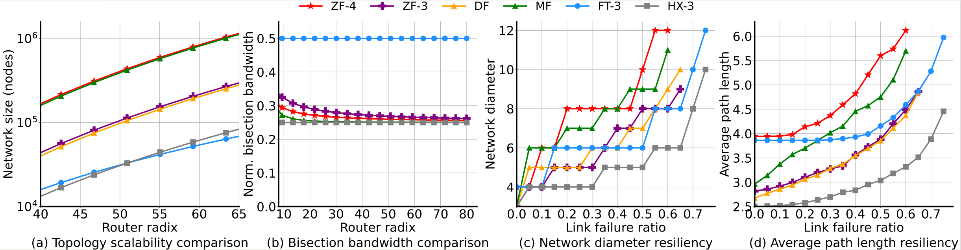
Theoretical Analysis of Zettafly
The scalability, bisection bandwidth, and link resiliency of Zettafly-4 and Zettafly-3 are similar to those of Megafly and Dragonfly.
Notes:
Next, we will delve deeper into Zettafly. Zettafly-4 and Zettafly-3 are similar to Megafly and Dragonfly in scalability, bisection bandwidth, and link resilience. The diameters of Zettafly-4 and Zettafly-3 are 4 and 3, respectively. Using radix-64 routers, Zettafly-4 and Zettafly-3 can approximately support up to 1,080,000 and 278,000 nodes, respectively.

Slide 21
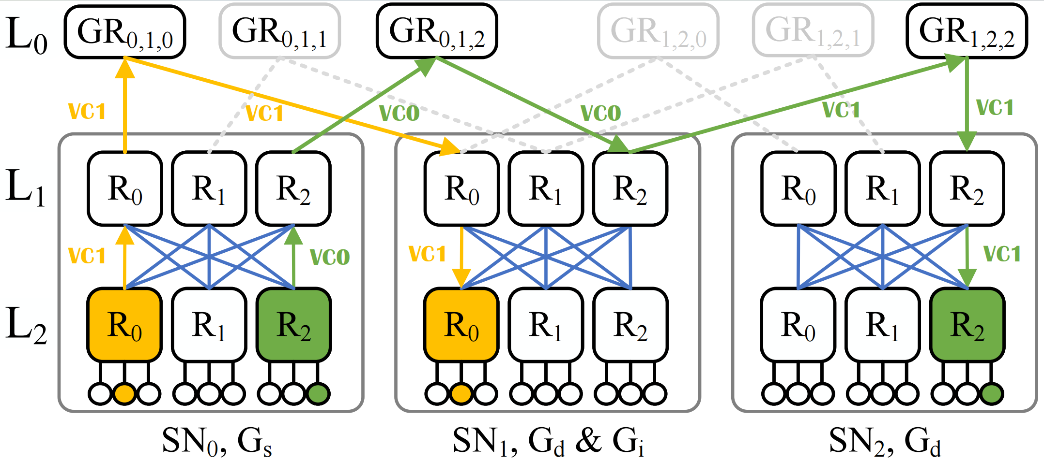
Routing in Zettafly-4
Sub-Network Adaptive Load-Balancing (SNAL)
1）If the destination and source routers are in the same SN, minimal routing is applied
2）Otherwise, route upwards to a random L₁ router within the group and adaptively select between the minimal path and the Valiant path based on congestion conditions.
Notes:
The yellow path in the figure represents minimal routing, where packets follow the shortest path to the destination, requiring only 1 virtual channel to avoid deadlock. The green path represents the Valiant path. A Valiant path is defined as randomly selecting an intermediate group, where the packet is minimally routed to the intermediate group and then minimally routed to the destination. Valiant routing needs 2 virtual channelss to avoid deadlock. Next, we present Sub-Network Adaptive Routing (SNAL). If the destination is within the same sub-network, minimal routing is used directly; otherwise, routing strategy is adaptively determined. When evaluating path congestion, SNAL defaults to the strategy in UGAL, which is the product of path hops and queue length.

Slide 22
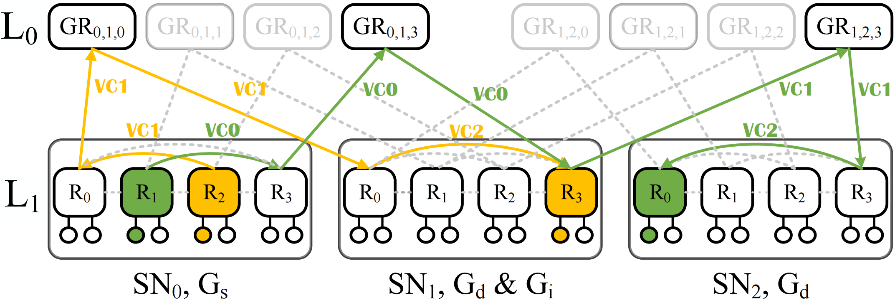
Routing in Zettafly-3
Sub-Network Adaptive Load-Balancing (SNAL)
1）If the destination router is the same as the source router, route minimally.
2）If the destination and source routers are in the same group, route adaptively.
3）If the destination and source routers are in the same SN, MIN-NB is applied.
4）Route to a random router within the group, and adaptively evaluate the congestion of minimal and Valiant paths, directing the packet along the path with the least congestion.
Notes:
The routing algorithms of Zettafly-3 are similar to Zettafly-4, with minimal routing requiring 2 virtual channels, and adaptive routing requiring 3 virtual channelss. Due to time constraints, we will not provide a detailed explanation.

Slide 23
Advantages of adaptive routing in Zettafly
1) Perfect network isolation for small jobs placed within a single group
Valiant paths do not pass through any local links of intermediate groups.
Notes:
We briefly summarize the advantages of adaptive routing on Zettafly. First, it provides perfect network isolation for small jobs within a single group. As shown by the two red circles in the figure, Valiant paths in Zettafly are forwarded immediately upon reaching the intermediate groups, ensuring no non-minimal traffic competes for local bandwidth in the intermediate groups. This means small jobs within a single group are unaffected by network noise.

Slide 24
Advantages of adaptive routing in Zettafly
2) More accurate congestion detection
Notes:
Zettafly also achieves more precise congestion awareness. The global links are the only places where congestion might occur in Zettafly. Zettafly ensures that when the router needs to make adaptive routing decisions, the global links of both the minimal path and the Valiant path will be directly connected to it. This allows routers in Zettafly to more directly and accurately sense the congestion status of the global links.

Slide 25
Advantages of adaptive routing in Zettafly
3) Less resource consumption
The adaptive routing of Zettafly-4 and Zettafly-3 uses only 2 and 3 VCs respectively, which is fewer than those required by the Dragonfly and HyperX topologies.
Simpler and more direct path hop calculation
Notes:
Compared to Dragonfly or HyperX, Zettafly's adaptive routing requires only 2–3 VCs and involves simpler hop count calculations, resulting in lower memory and computation costs.

Slide 26
Evaluation configurations
Synthetic Evaluation
Network scale is about 10,000 nodes.
Link latency is 1 cycle, and the internal speedup of the router is 4.0.
VC size is 128 flits.
Zettafly-3 and Zettafly-4 use SNAL, Dragonfly uses PiggyBack routing, fat-tree uses NCA, HyperX and Megafly use UGAL.
GPCNet benchmark
Network scale is about 320 nodes.
DCQCN is used for all networks.
The RDMA NIC supports 256 connections.
The rate of RNICs and links are set to 100 Gbps.
Notes:
Next is the experimental section, divided into two parts: synthetic workloads and GPCNet benchmark. The experimental setup is largely consistent with previous studies.

Slide 27
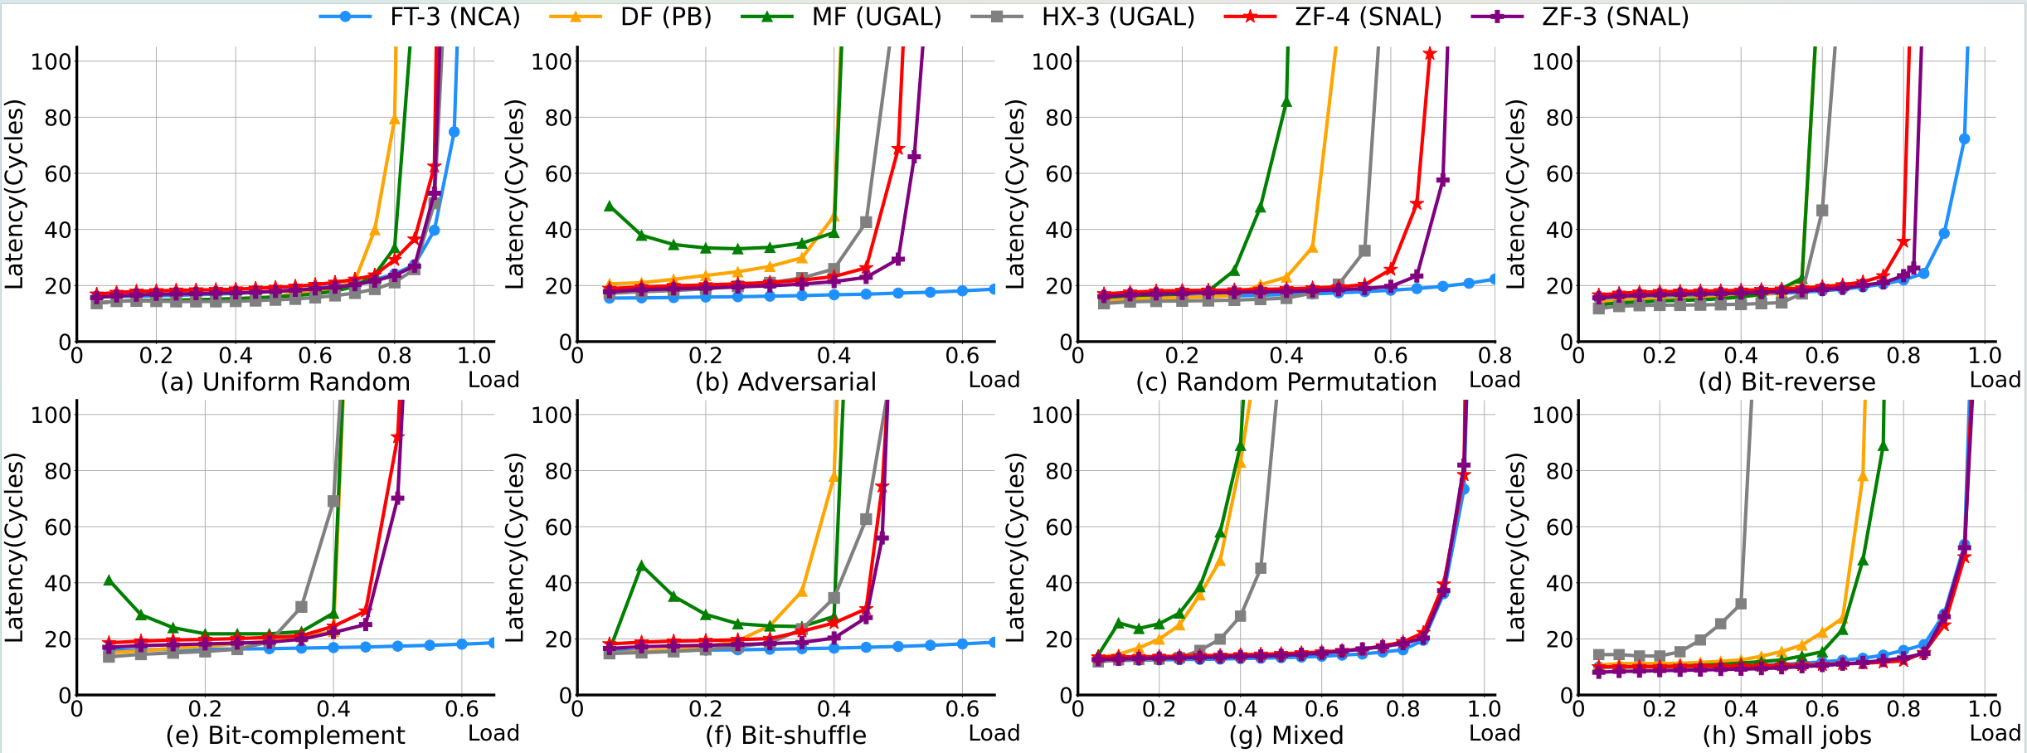
Performance of synthetic evaluation
Zettafly-4 and Zettafly-3 outperform non-fat-tree topologies by over 40% on average.
Notes:
We measured multiple traffic patterns, and the average performance of Zettafly-4 and Zettafly-3 exceeds all topologies other than Fat-Tree by over 40%. We also evaluated a custom mixed traffic pattern that deploys six different traffic patterns ˌsaɪ.məlˈteɪ.ni.əs.li on the network. In Zettafly, each traffic pattern is fully deployed within a single non-blocking sub-network, achieving performance equivalent to that of Fat-Tree. We believe this mixed traffic pattern more accurately reflects parallel multi-job scenarios in real systems.

Slide 28
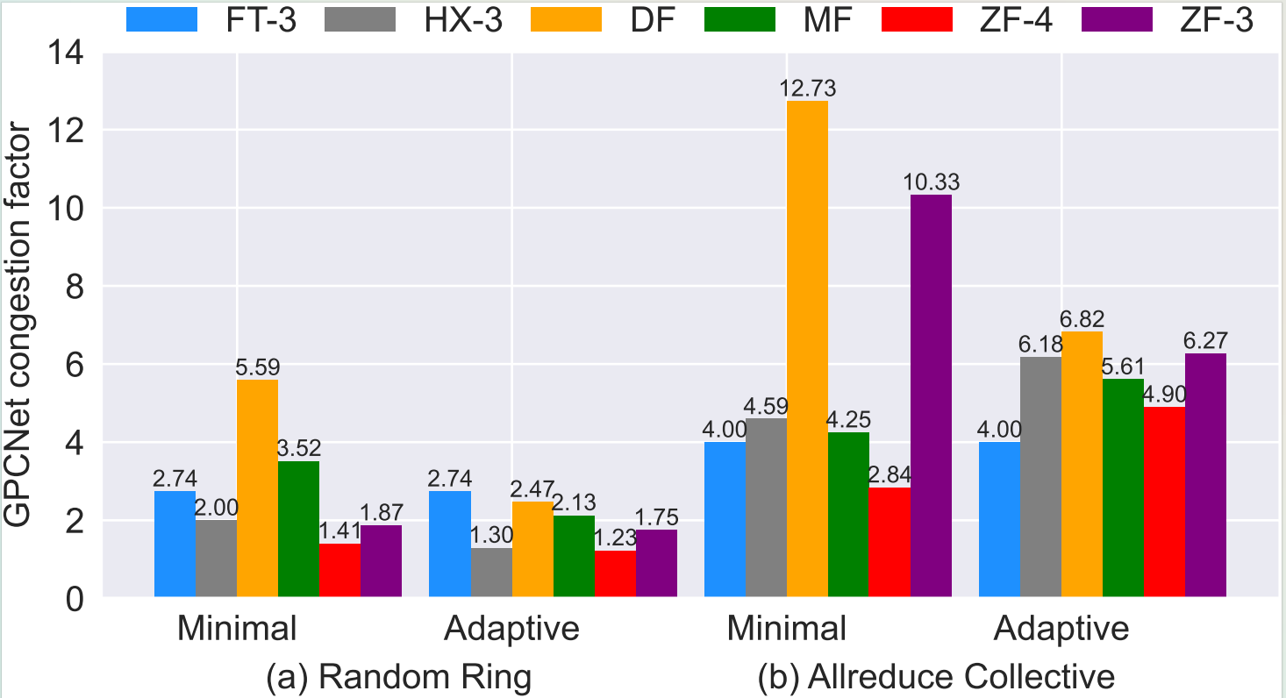
Performance of GPCNet benchmark
Zettafly-4 achieves the best performance, Zettafly-3 performs similarly to HyperX and surpasses Dragonfly.
Notes:
For the GPCNet test results, Zettafly also achieved excellent performance.

Slide 29
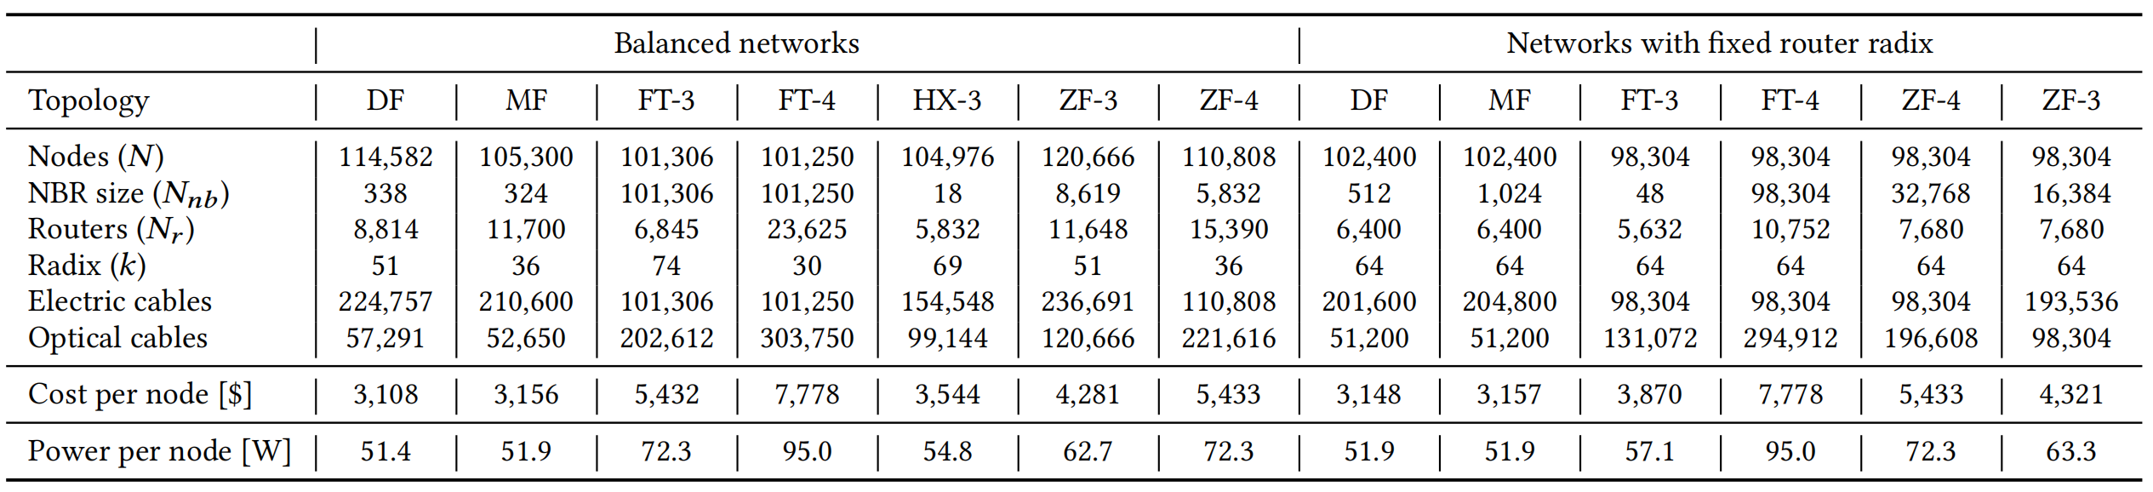
Cost model
The cost model was based on the Mellanox QM8700-HS2F switch and Mellanox HDR 200Gb/s QSFP56.
Due to the use of more switches and global links, the per-node cost of Zettafly-4 ($5,433) and Zettafly-3 ($4,281) is higher than that of Dragonfly ($3,108).
Notes:
We evaluated the cost of various topologies during large-scale deployment. Due to the use of more switches and global links, Zettafly is more expensive than Dragonfly and HyperX.

Slide 30
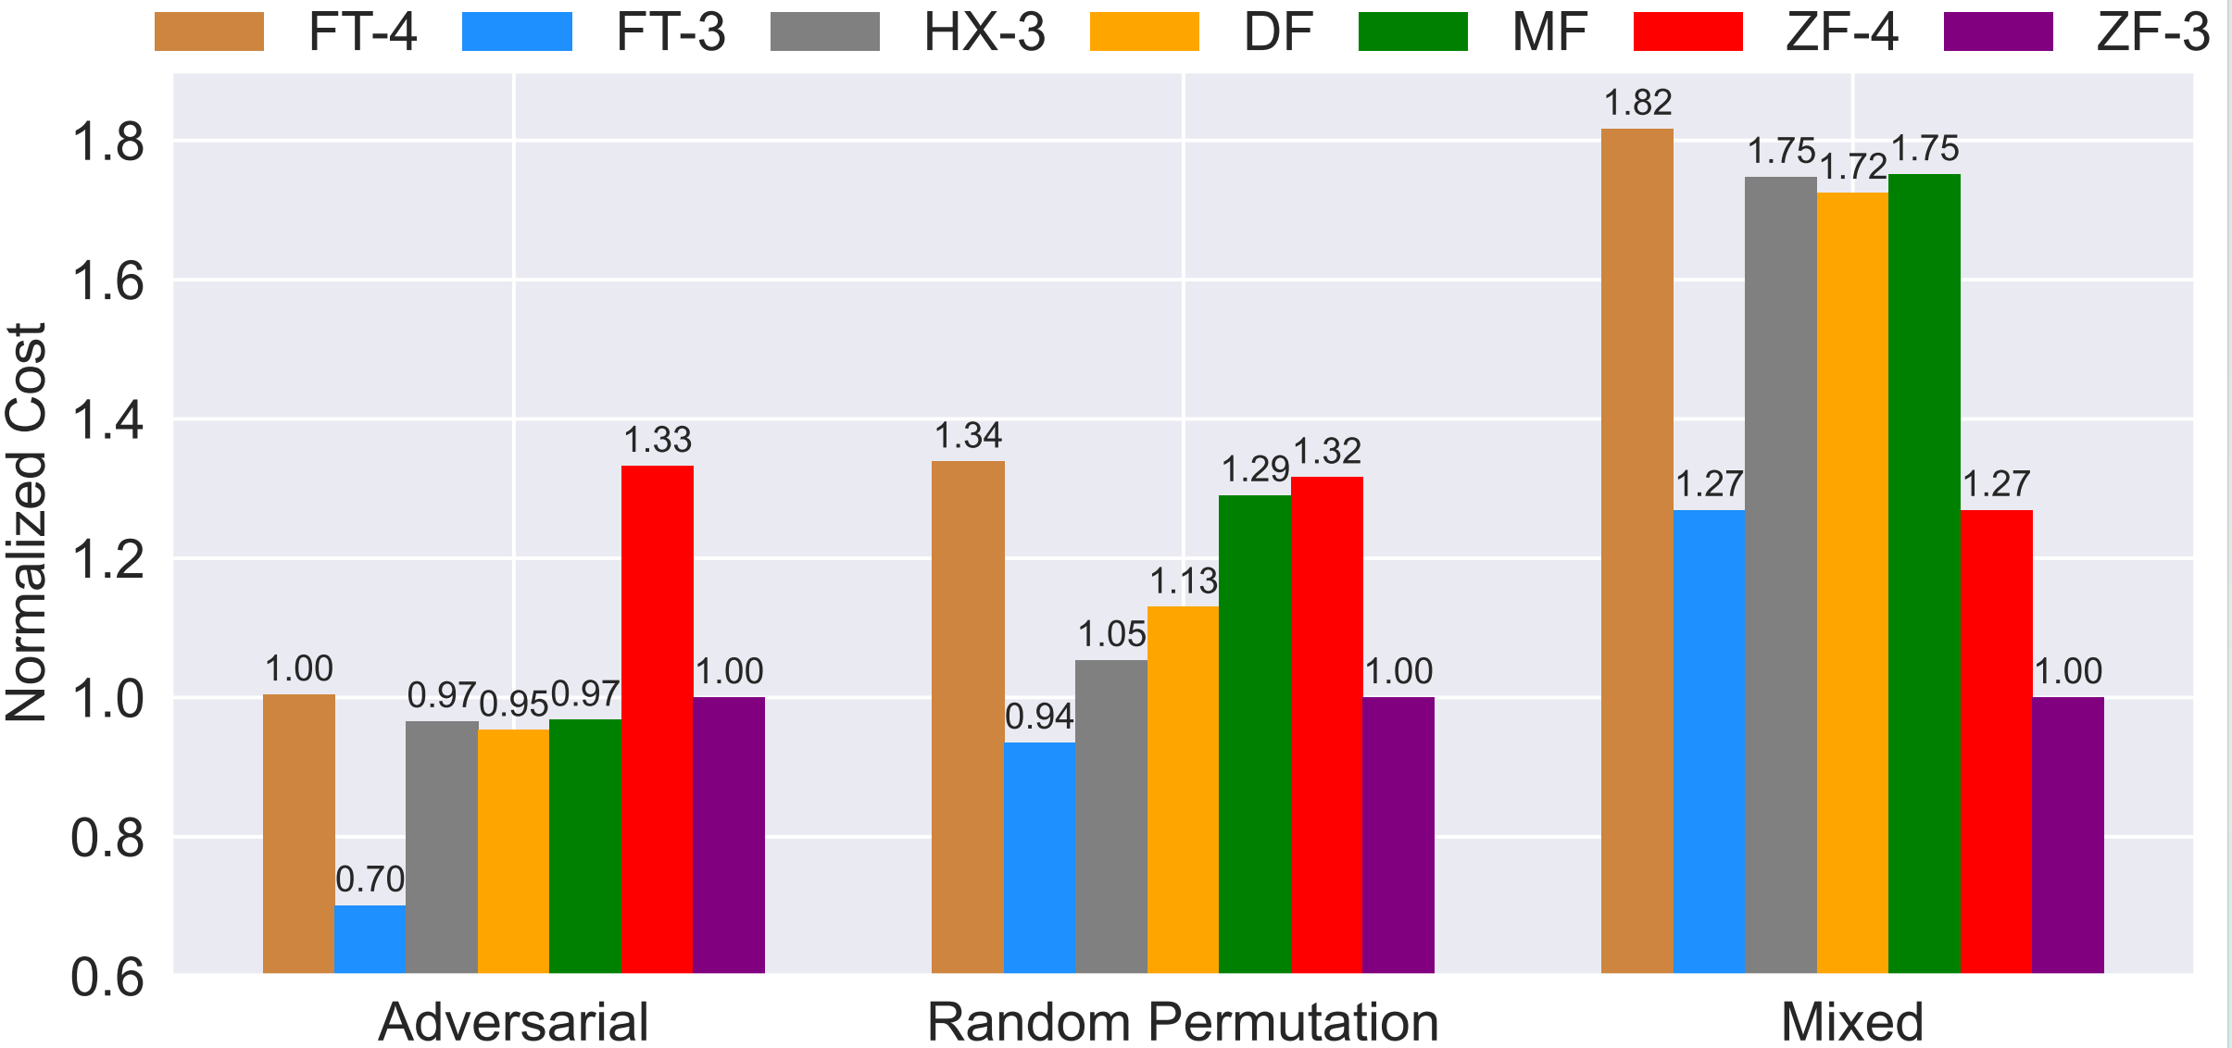
Weighted cost model
Weighted Cost = Cost_per_node/Throughput
In the mixed traffic mode, Zettafly-3 and Zettafly-4 demonstrate significant cost efficiency.
Notes:
We also introduced a weighted cost model to evaluate Zettafly's cost-effectiveness under different traffic patterns, defined as cost per node divided by throughput and normalized to Zettafly-3. Zettafly shows significant cost-effectiveness in mixed traffic patterns that better represent real systems.

Slide 31
Topology-aware job placement algorithm
Replay approximately 44,000 jobs from the 2023 job logs of the Theta supercomputing system onto the Zettafly network.
Topology-aware job placement algorithm:
1) Attempt to place jobs within a single sub-network; if unsuccessful,
2) Fill the sub-network with the highest number of available idle nodes, and place overflow nodes onto other sub-networks.
Approximately 95.0% of small to medium-sized jobs were successfully allocated within the subnet, occupying 67.1% of their core hours.
Notes:
Due to potential system fragmentation, small-to medium jobs may not always be placed entirely within a single sub-network. To quantify the proportion of small and medium-sized jobs that can be isolated within a single sub-network under realistic scenarios, we reallocate approximately 44,000 jobs from Theta’s 2023 job logs onto a Zettafly network based on the topology-aware job placement algorithm. We define the algorithm as follows: jobs are first placed within a single sub-network, and if unsuccessful, the sub-network with the most idle nodes is filled first, with overflow nodes placed in other sub-networks. Considering the use of 64-radix routers, a single sub-network of ZF-4 can support up to 32,768 nodes. Therefore, future large-scale systems may only have 3-6 sub-networks. We set Zettafly’s node count to match Theta, then ran four simulations assuming 3, 4, 5, and 6 sub-networks. On average, for all jobs smaller than a sub-network, 95.0% were placed within one sub-network, accounting for 67.1% of their core-hours.

Slide 32
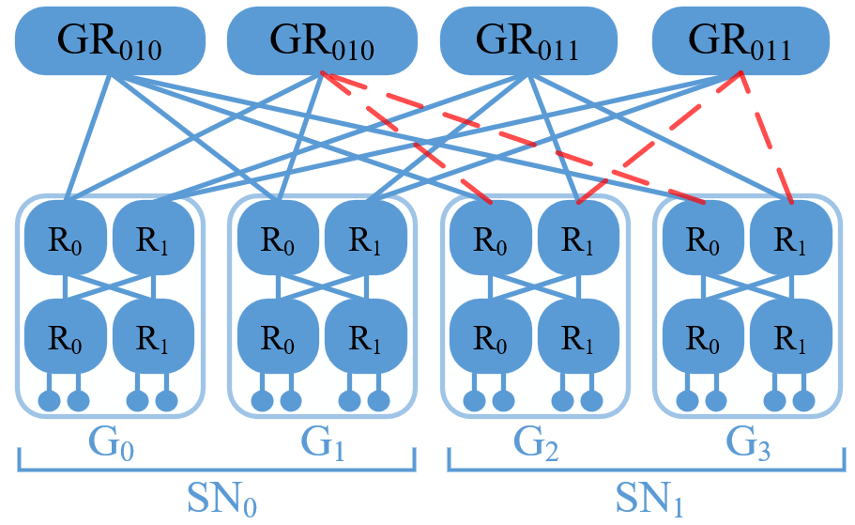
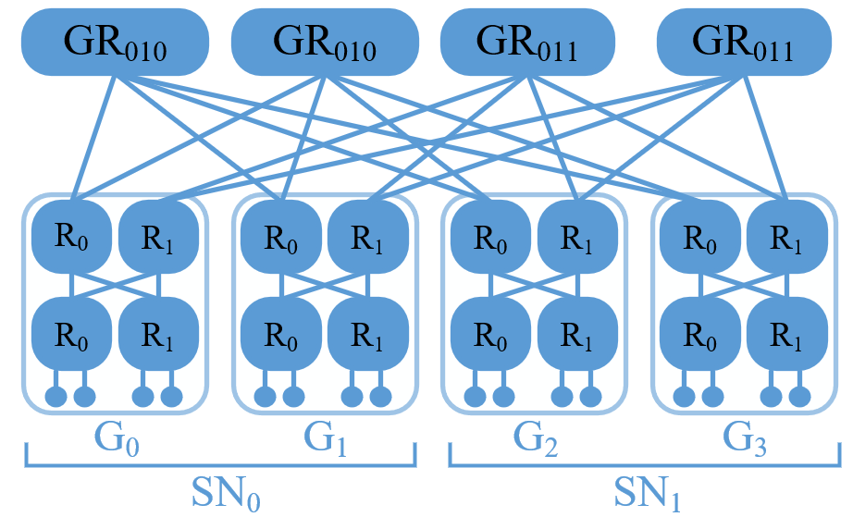
Sub-network level incremental deployment
A saturated non-blocking fat-tree can be regarded as consisting of two sub-networks.
Legacy system （a saturated fat-tree）
Notes:
Zettafly also supports sub-network-level incremental deployment effectively. A saturated non-blocking fat-tree can be viewed as consisting of two sub-networks, and adding one more sub-network transforms it into a Zettafly-4 network.

Slide 33
Sub-network level incremental deployment
Disconnecting 25% of the global links results in a tapered fat-tree network.
System under upgrade（a tapered fat-tree）
Notes:
During system upgrades, 25% global links need to be disconnected, causing temporary oversubscription in sub-network 1, while sub-network 0 remains unaffected.

Slide 34
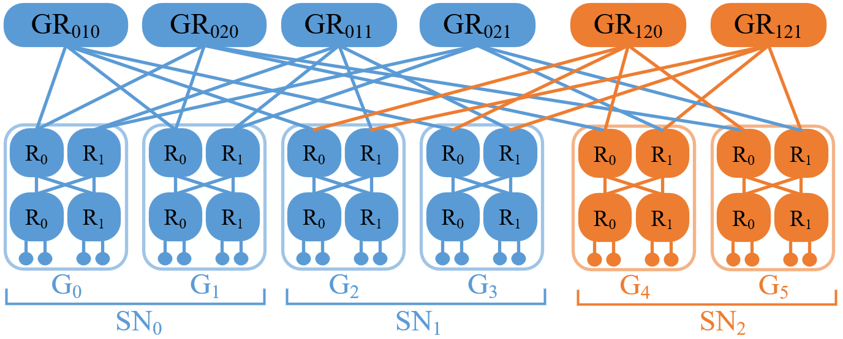
Sub-network level incremental deployment
Combining disconnected links with new equipment forms a Zettafly-4 network with three SNs.
Updated system（Zettafly-4）
Notes:
The disconnected links are then combined with newly purchased equipment to form a Zettafly-4 network with 3 sub-networks. Notably, the network remains operational throughout the upgrade process, ensuring zero downtime.

Slide 35
Thank you for listening.
Email:wangziyu@nudt.edu.cn;
Profile Page:https://artanis-wang.github.io
Notes:
Thank you all for listening! You are welcome to contact me via email for any further questions, and I will respond as soon as possible.

